Slide 1
Inverse Learning Problem

Slide 2
Problem Formulation
Given f(xm), and {alpha, beta,…}, we can derive the forward model that generates d, hence obtaining e
From d or e, which is what we can experimentally observe/measure?
1. Can we learn about f(xm), given {alpha, beta, …}?
2. Can we learn about {alpha, beta, …}

Slide 3



Training Image
$$x_{m}$$
$$u$$
$$v$$
Testing Image

Slide 4
1. For simplicity, let’s focus on the important problem. Can we inversely learn a and b?
Given d, can we inversely learn a, b?
f1(xm) = sum_{n} an*Ln(xm);
f2(xm) = sum_{n} bn* Ln(xm)
Factors:
Condition number of FEM stiffness matrix K
Mesh size
Order: n = 1,2,10
Complication, tensor C(alpha, bete, gamma, omega) is anisotropic
Ln(xm) is a Legendre Polynomial with order number n
BASIC TESTS
1. Mesh size
2. Degrees of Legendre series
1) Mesh size is important: finer grids made inverse problem result more accurate…
2) Stiffness matrix problem:
(a)singular for pure Neumann condition; result not unique;
(b) but we can constrain it by fixing points -> robust optimization
(c) Condition number of the problem: too fine of a grid will compromise computation accuracy:
trade-off between fine grid and course mesh
*** 3) How does order affect the result?
/Doesn’t seem to affect too much

Slide 5
A = [a1,a2,a3…,aN]
ai = param(:)
All experiments iterated 100 times unless otherwise stated
C is isotropic
COND(K) | ||A_true – A_retrieval||_2
1e20 | O(1)
1e5 | 1.5e-15
Mesh: hmax\Order | 1 | 2 | 10
5 | 1.2e-14 | 2.4e-13 | 3.68e-9
5e-1 | 4.98e-15 | 2.47e-14 | 1.98e-12
5e-2 | 2.51e-14 | 3.73e-14 | 5.7e-13
5e-3 (s) | 8.9e-14 (65)
AVGCOND = 1e5
Too long

Slide 6
What are the acceptable perturbations for retrieval?
Function recovery
Exact recovery
a
b
c
Higher order polynomial harder to retrieve exactly.
Tolerance level is <= 8% signal magnitude noise for d, assuming noise is Gaussian and independent in each pixel.

Slide 7
When C is anisotropic, how would this affect our retrieval? (Computation will be slower)
Mesh: hmax\Order | 1 | 2 | 10
5
5e-1
5e-2
5e-3 (s)
AVGCOND = 1e5
What are the acceptable perturbations for retrieval?
Mesh: hmax\Order | 1 | 2 | 10
5
5e-1
5e-2
5e-3(s)

Slide 8


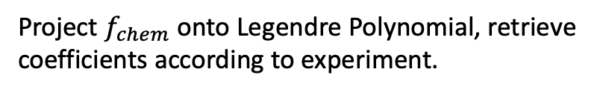


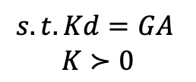
Experimental data
Inverse Learning:
$$\min_{A} F:={\left(\hat{d}−d\right)}^{T}\left(\hat{d}−d\right)$$
$$s.t. ∇\left(C⋅∇d\right)=∇(C⋅f_{chem}(x_{m}))$$
Project $f_{chem}$ onto Legendre Polynomial, retrieve coefficients according to experiment.
Discretization with FEM:
A is the coefficient matrix
G is the assembled Legendre Polynomial Matrices
$$\min_{A} F:={\left(\hat{d}−d\right)}^{T}\left(\hat{d}−d\right)$$
$$s.t. Kd=GA$$
$$K≻0$$
Unconstrained Quadratic Programming
N = 2

Slide 11
2. Can we inversely learn {alpha, beta, gamma, omega}?

Slide 12
Experimental Data:

Slide 13
Real experimental data

Slide 14
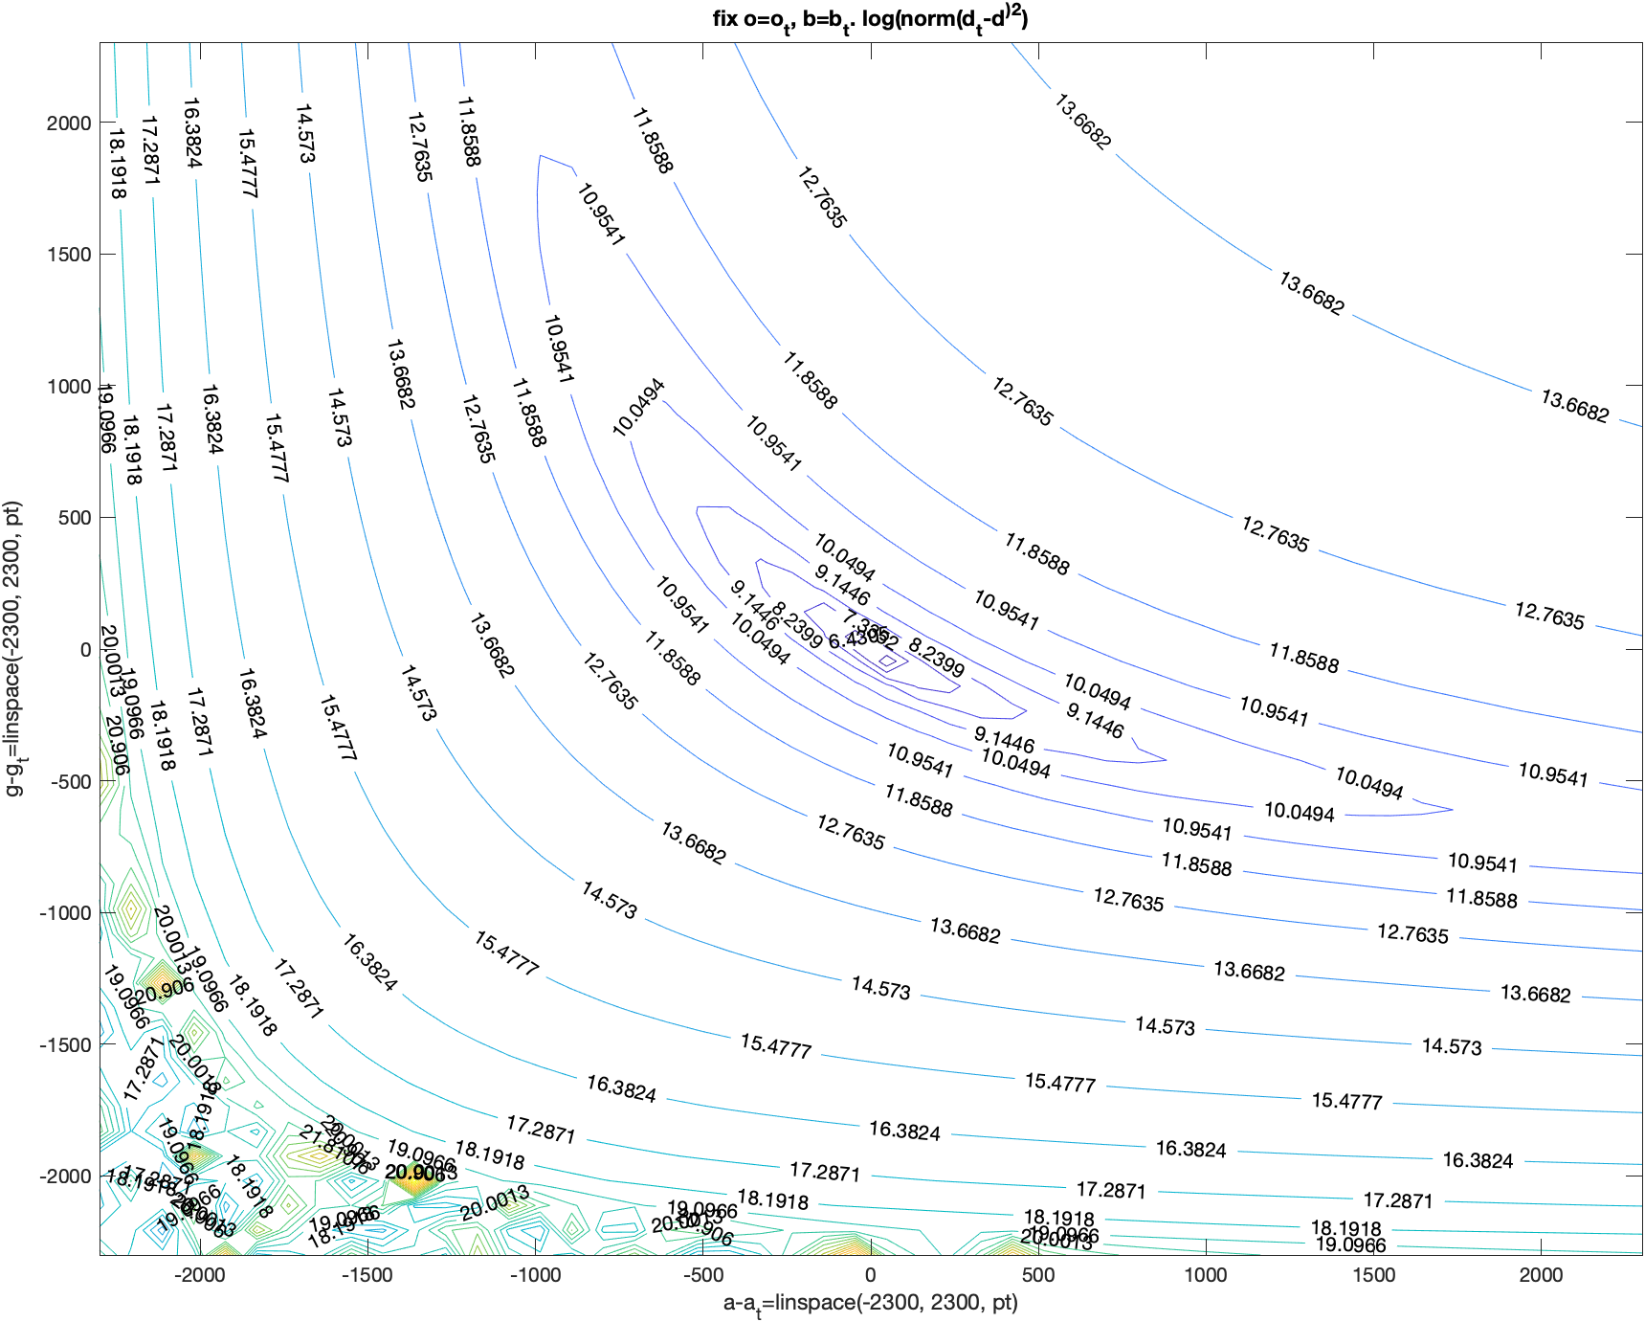
When f is a constant:
Fix omega and beta.
Take 50 gamma and 50 alpha.
Compute log(norm^2)
Colormap: fconstant_1_pt50.fig

Slide 15
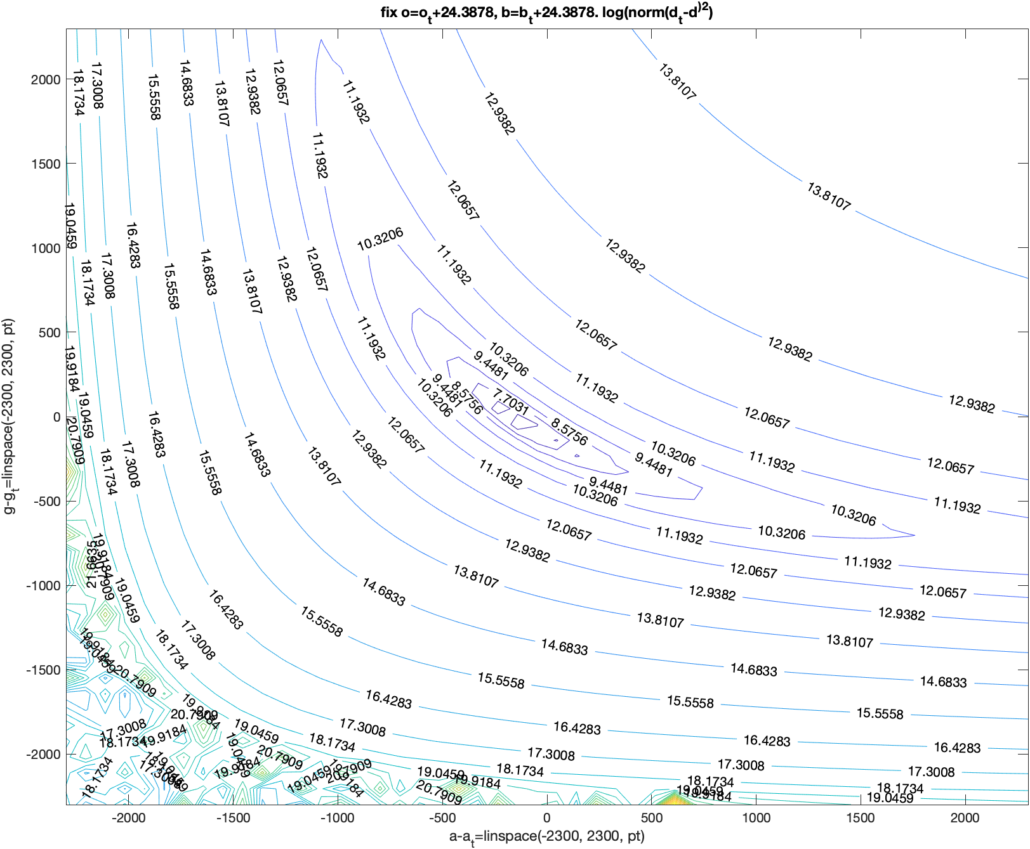
When f is a constant:
Fix omega and beta.
Take 50 gamma and 50 alpha.
Compute log(norm^2)
Colormap: fconstant_2_pt50.fig

Slide 16
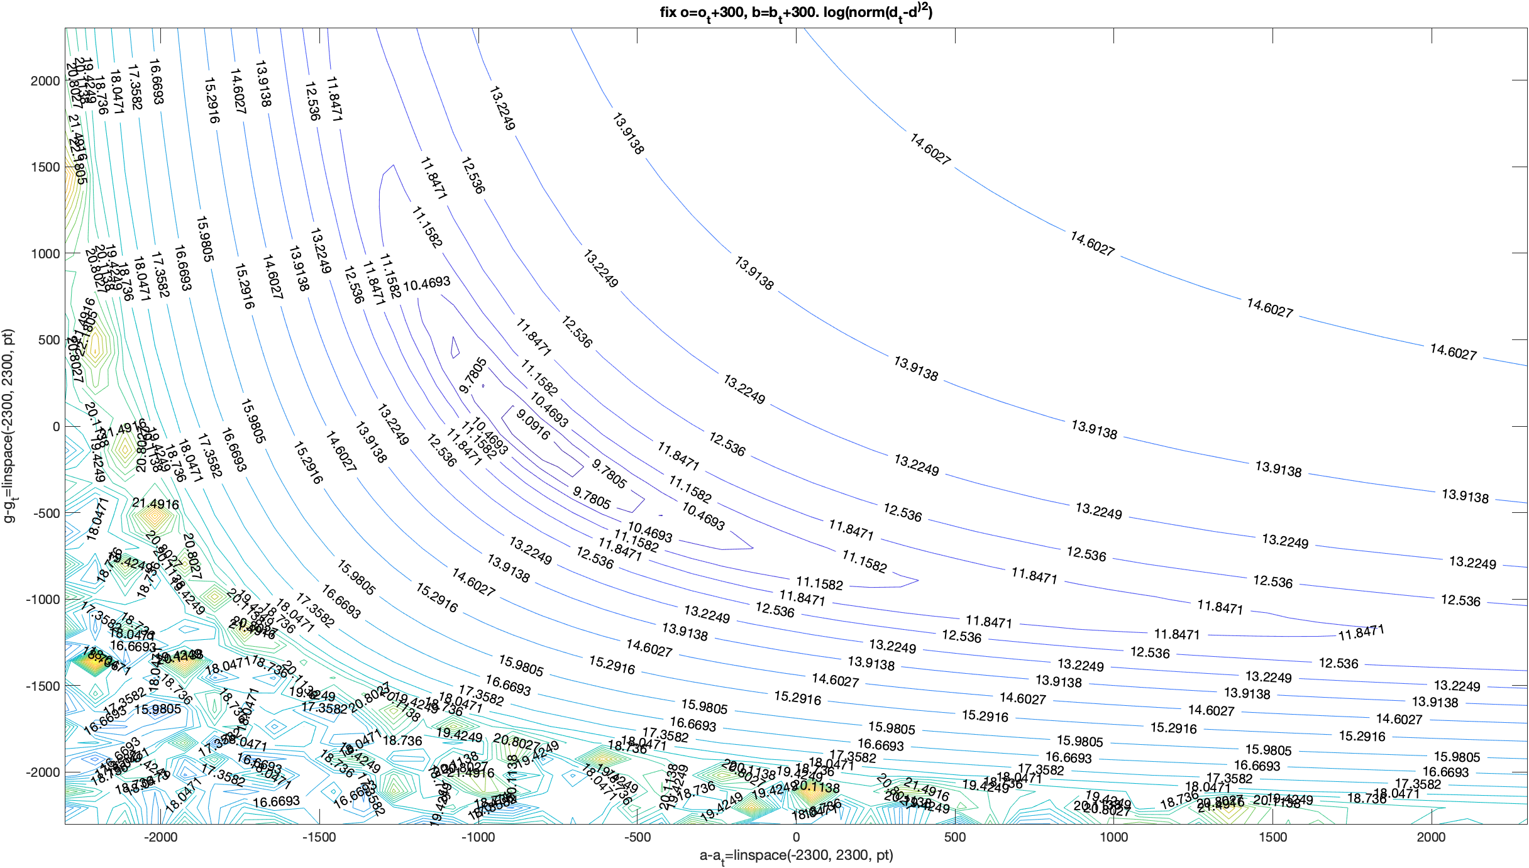
When f is a constant:
Fix omega and beta.
Take 50 gamma and 50 alpha.
Compute log(norm^2)
Colormap: fconstant_3_pt50.fig

Slide 17
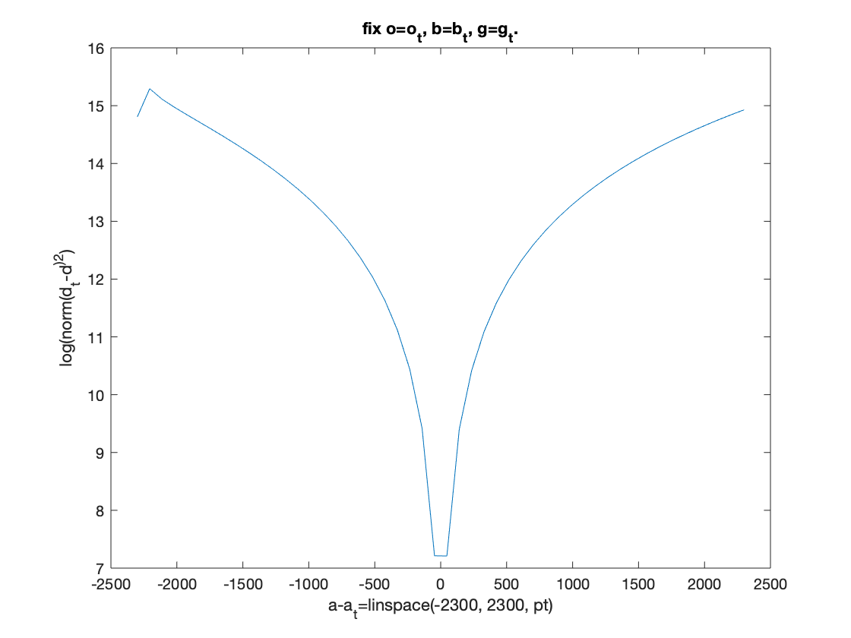
When f varies at each point:
Fix gamma, omega and beta.
Take 50 alpha.
Compute log(norm^2)

Slide 18
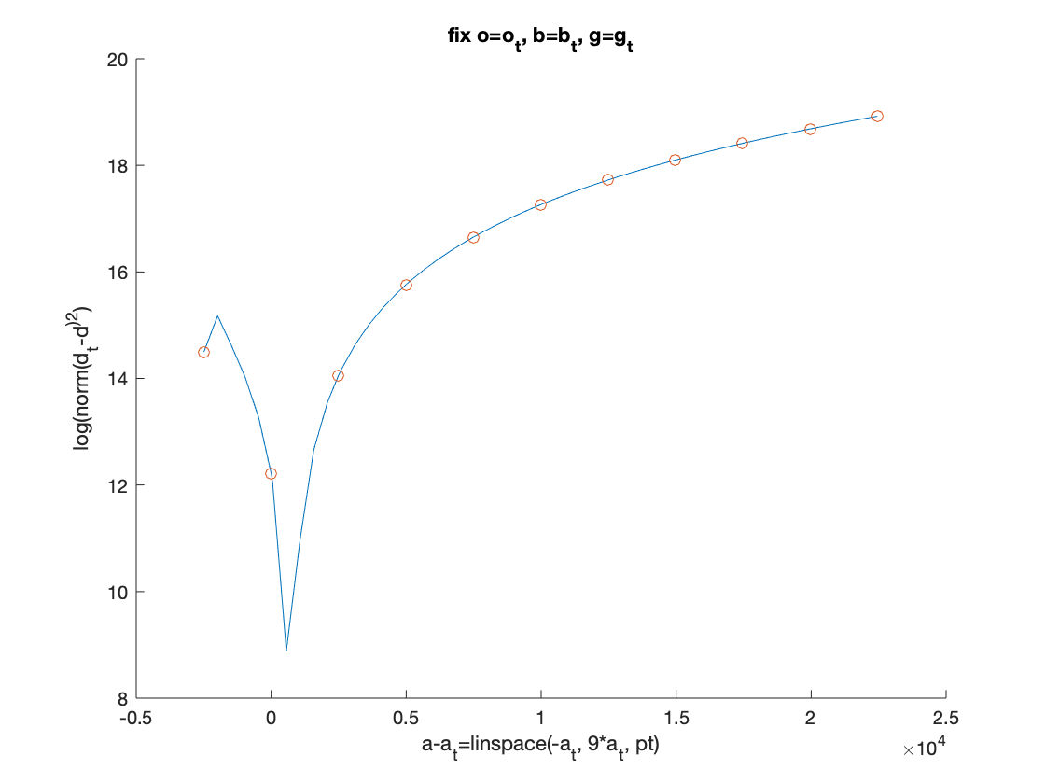
When f varies at each point:
Fix gamma, omega and beta.
Alpha range from 0 to 10*a_t.
Compute log(norm^2)
Circles are 0~10*a_t

Slide 19
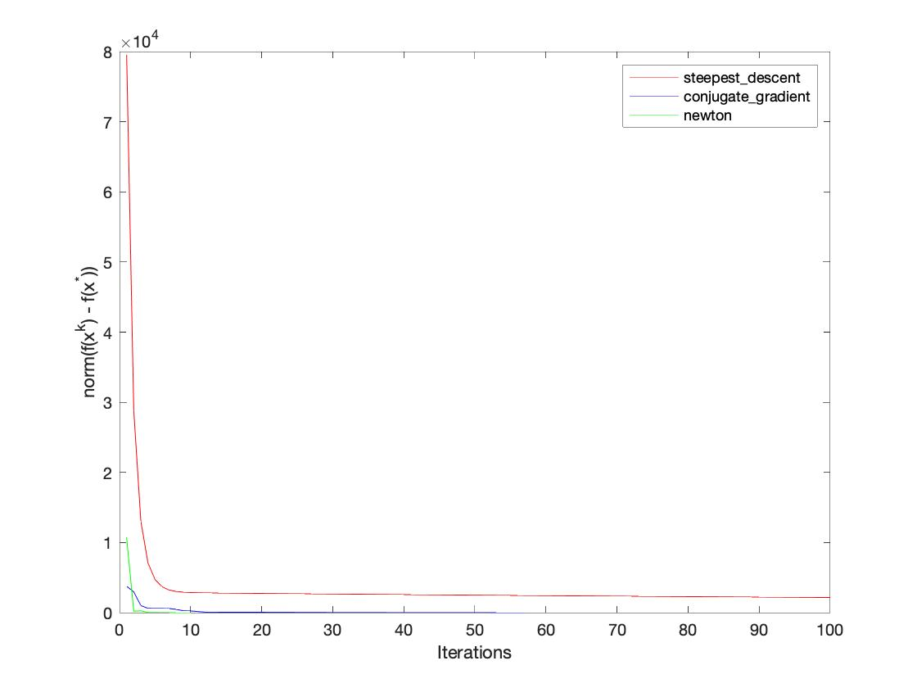
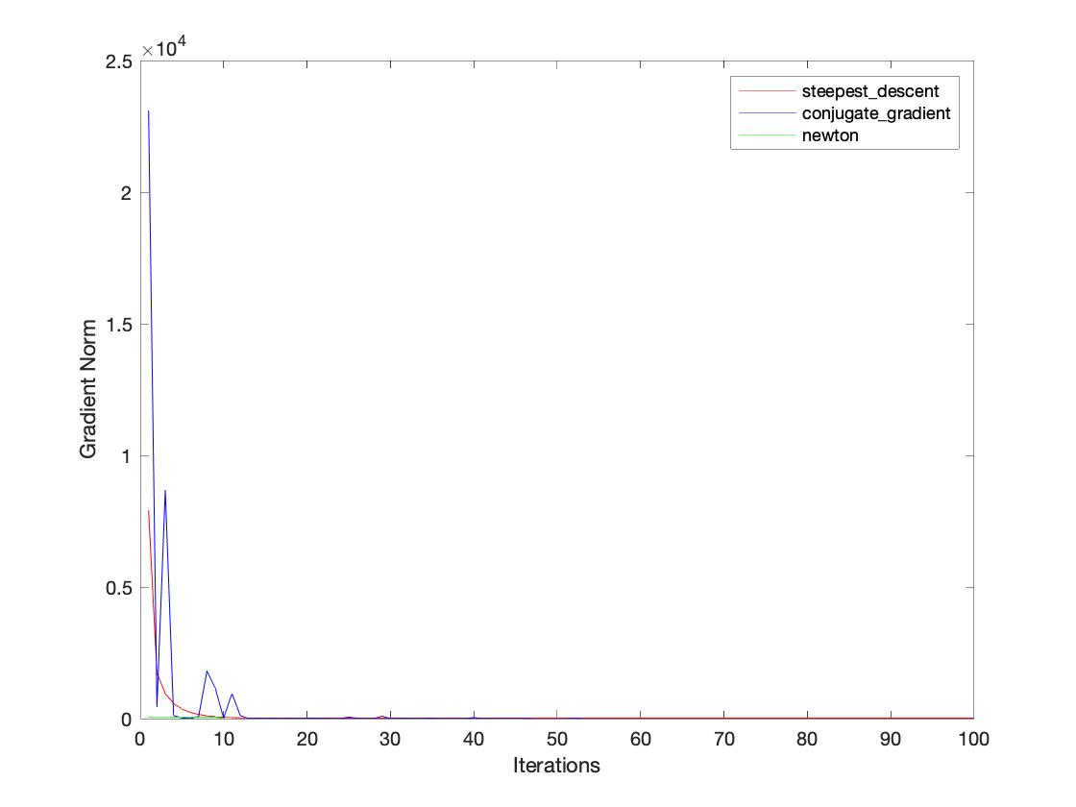
Comparison of three algorithms: steepest descent (SDM), conjugate gradient (CG), and newton method:
Here, f is a constant. We compared||f(x^k)-f(x*)|| and ||df(x^k)||.
With initial values a0 = 2.0e3; b0 = 700; g0 = 2.0e3; o0 = 800, SDM converges after 5000 iterations;
CG converges in 54 iterations; Newton method converges in 10 iterations.
||f(x^k)-f(x*)||
||df(x^k)||
When f is a variable, I ran CG but it got an error. 10 iterations took about 2 hours to run…
With many other initial values, Newton method is not guaranteed to work.

